Slide 1
XML
Week 4 Session 2

Slide 2
What is XML?
XML is a markup language similar to HTML. It stands for Extensible Markup Language and is a W3C recommended specification as a general purpose markup language.
This means, unlike other markup languages, XML is not predefined so you must define your own tags.
The primary purpose of the language is the sharing of data across different systems, such as the Internet.

Slide 3
XML
XML stands for eXtensible Markup Language.
XML was designed to describe data.
XML is a software- and hardware-independent tool for carrying information.
http://www.w3schools.com/xml/default.asp

Slide 4
Advantage
XML Separates Data from HTML
XML Simplifies Data Sharing
XML Simplifies Data Transport
XML Simplifies Platform Changes
XML Makes Your Data More Available

Slide 5
Example:
<?xml version="1.0" encoding="UTF-8"?>
<?xml-stylesheet type="text/css" href="course_list.css"?>
<CourseList>
<Course>
<Title>Introduction to Databases</Title>
<Description>Introduction to Databases Description</Description>
<Id>ISCG5423</Id>
<prerequisite>non</prerequisite>
<Credits>15</Credits>
<Level>5</Level>
</Course>
<Course>
<Title>Hardware Fundamentals</Title>
<Description>Description Hardware Fundamentals</Description>
<Id>ISCG5400</Id>
<prerequisite>non</prerequisite>
<Credits>15</Credits>
<Level>5</Level>
</Course>
</CourseList>

Slide 6
Other Example
<?xml version="1.0" encoding="UTF-8"?>
<?xml-stylesheet type="text/css" href="product_list.css"?>
<ProductList>
<Product>
<ProductName>milk</ProductName>
<Image>milk.jpg</Image>
<Price>5</Price>
</Product>
<Product>
<ProductName>agria potatoes</ProductName>
<Image>agria_potatoes.jpg</Image>
<Price>20</Price>
</Product>
</ProductList>

Slide 7
Formed XML Documents -rules
XML documents must have a root element
XML elements must have a closing tag
XML tags are case sensitive
XML elements must be properly nested
XML attribute values must be quoted

Slide 8
XML Validator
http://www.w3schools.com/xml/xml_validator.asp

Slide 9
XML DTD <!DOCTYPE note SYSTEM "Note.dtd">
The DOCTYPE declaration, in the example above, is a reference to an external DTD file.
<!DOCTYPE note [ <!ELEMENT note (to,from,heading,body)> <!ELEMENT to (#PCDATA)> <!ELEMENT from (#PCDATA)> <!ELEMENT heading (#PCDATA)> <!ELEMENT body (#PCDATA)> ]>

Slide 10
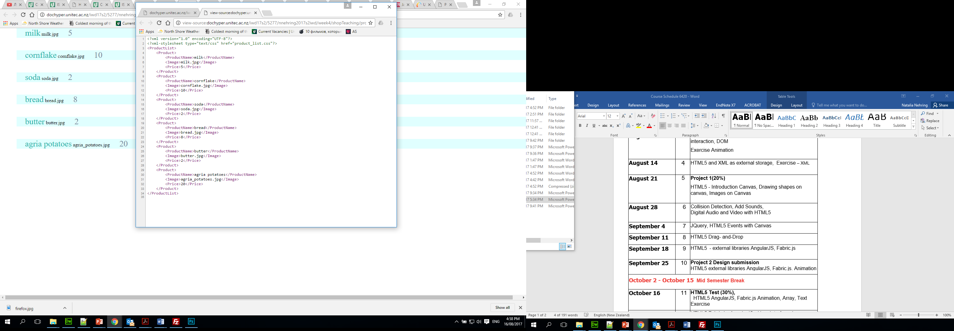
XML with CSS display

Slide 11
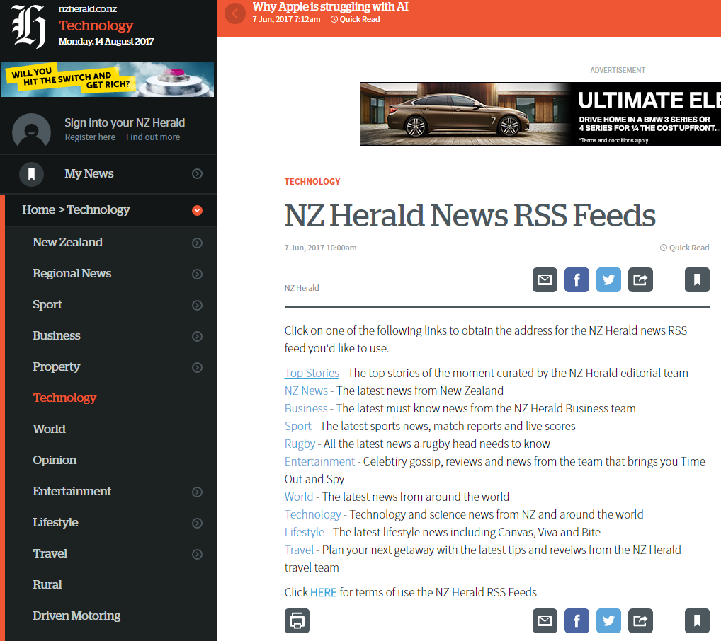
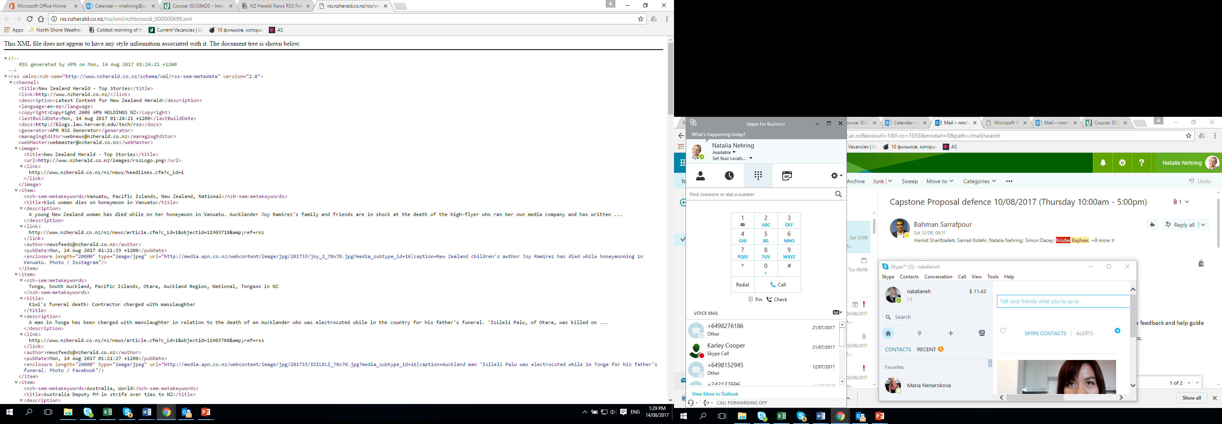
Example -NZ Herald – RSS feed
http://www.nzherald.co.nz/rss/
http://rss.nzherald.co.nz/rss/xml/nzhrsscid_000000001.xml

Slide 12
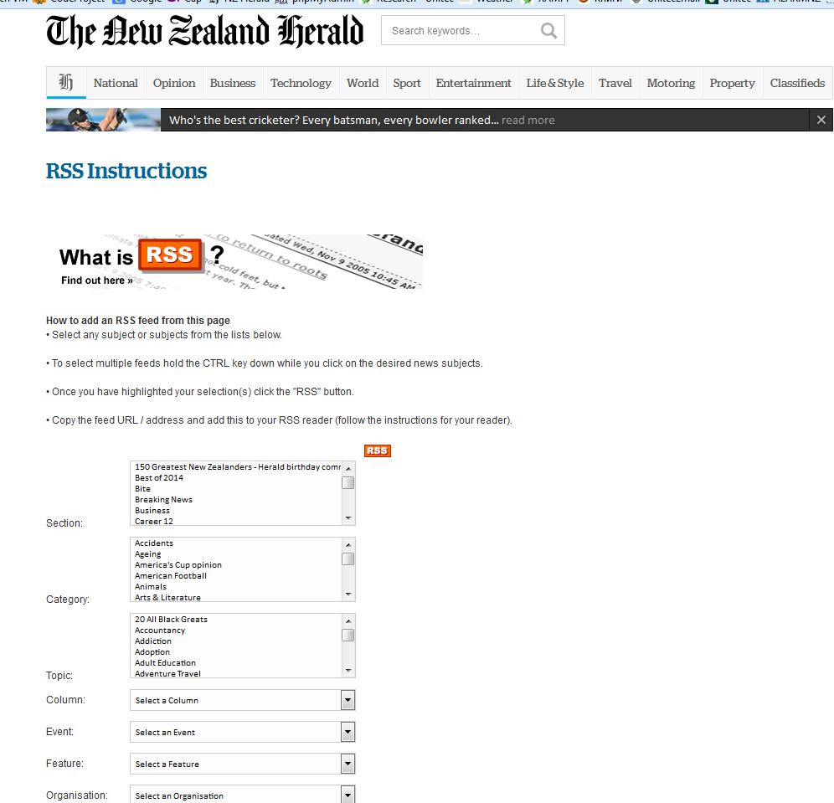
RSS (Rich Site Summary) - User interface of a feed reader
http://www.nzherald.co.nz/rss/
http://rss.nzherald.co.nz/rss/xml/nzhrsscid_000000003.xml
RSS feeds enable publishers to syndicate data automatically.
A standard XML file format ensures compatibility with many different machines/programs.
RSS feeds also benefit for timely updates from favourite websites or to aggregate data from many sites.

Slide 13
The XMLHttpRequest Object
The XMLHttpRequest object is used to exchange data with a server behind the scenes.
The XMLHttpRequest object is a developer's dream, because you can:
Update a web page without reloading the page
Request data from a server after the page has loaded
Receive data from a server after the page has loaded
Send data to a server in the background

Slide 14
Access Across Domains
For security reasons, modern browsers do not allow access across domains.
This means that both the web page and the XML file it tries to load, must be located on the same server.
The examples on W3Schools all open XML files located on the W3Schools domain.
If you want to use the example above on one of your own web pages, the XML files you load must be located on your own server.

Slide 15
Parse an XML String
Browsers use the DOMParser object.
txt="<bookstore><book>"; txt=txt+"<title>Everyday Italian</title>"; txt=txt+"<author>Giada De Laurentiis</author>"; txt=txt+"<year>2005</year>"; txt=txt+"</book></bookstore>"; parser=new DOMParser(); xmlDoc=parser.parseFromString(txt,"text/xml");

Slide 16
Create an XMLHttpRequest Object
All modern browsers (Firefox, Chrome, Safari, and Opera) have a built-in XMLHttpRequest object.
Syntax for creating an XMLHttpRequest object:
xmlhttp=new XMLHttpRequest();

Slide 17
Parse an XML Document
The following code fragment parses an XML document into an XML DOM object:
xmlhttp=new XMLHttpRequest(); xmlhttp.open("GET","books.xml",false); xmlhttp.send(); xmlDoc=xmlhttp.responseXML;

Slide 18
XML DOM
The XML DOM
The XML DOM defines a standard way for accessing and manipulating XML documents.
The XML DOM views an XML document as a tree-structure.
All elements can be accessed through the DOM tree. Their content (text and attributes) can be modified or deleted, and new elements can be created. The elements, their text, and their attributes are all known as nodes.
The HTML DOM
The HTML DOM defines a standard way for accessing and manipulating HTML documents.
All HTML elements can be accessed through the HTML DOM.

Slide 19
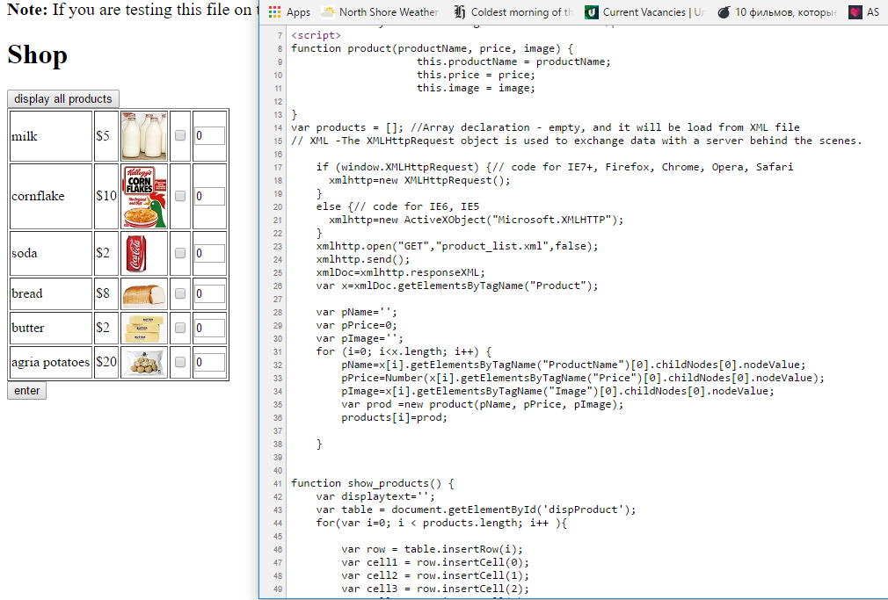
XML and HTML display

Slide 20
XMLHttpRequest cannot load file. Cross origin requests are only supported for HTTP
Test on Firefox, Deploy to Host
Firefox no longer allows Cross Origin Requests from files served from your hard drive
Your web hosting site will allow requests to files in folders as configured by the manifest file
Run a Local Server
Run a server on your computer, like Apache or Python
Python isn't a server, but it will run a simple server
http://stackoverflow.com/questions/20041656/xmlhttprequest-cannot-load-file-cross-origin-requests-are-only-supported-for-ht
https://addons.mozilla.org/en-US/firefox/addon/cors-everywhere/
https://chrome.google.com/webstore/detail/allow-cors-access-control/lhobafahddgcelffkeicbaginigeejlf

Slide 21
XMLHttpRequest Example
<script>
if (window.XMLHttpRequest)
{// code for IE7+, Firefox, Chrome, Opera, Safari
xmlhttp=new XMLHttpRequest();
}
else
{// code for IE6, IE5
xmlhttp=new ActiveXObject("Microsoft.XMLHTTP");
}
xmlhttp.open("GET","course_list.xml",false);
xmlhttp.send();
xmlDoc=xmlhttp.responseXML;
document.write("<table><tr><th>Course</th><th>Title</th></tr>");
var x=xmlDoc.getElementsByTagName("Course");
for (i=0;i<x.length;i++)
{
document.write("<tr><td>");
document.write(x[i].getElementsByTagName("Id")[0].childNodes[0].nodeValue);
document.write("</td><td>");
document.write(x[i].getElementsByTagName("Title")[0].childNodes[0].nodeValue);
document.write("</td></tr>");
}
document.write("</table>");
</script>

Slide 22
What is different on Chrome:
document.write(x[i].getElementsByTagName("Title")[0].childNodes[0].nodeValue);
Work on server and with single quote.
document.write(x[i].getElementsByTagName(‘Title’)[0].childNodes[0].nodeValue);

Slide 23
References
https://www.w3schools.com/

